Slide 1

Spotify
Song Recommendations by Mood
Author: Donna Lee

Slide 2




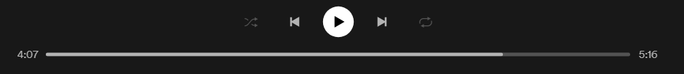


Business Problem
Home
Browse
Radio
In 2016, there were 1,482 genres on Spotify. As of December 2020, that number jumped to 5,071.
In the post streaming era, the traditional way of categorizing music is no longer cutting it.
So how does one decide what to listen to? Audio features and mood are a great place to start.
This project will predict the mood of a song based on the audio features and recommend songs that sound similar and fit a specific mood (as inputted by the user).
Table of Content:
Business Problem
Data Overview
Track Attributes
Mood Distribution
Prediction Models
Recommendation Model
Prediction Distribution
Class Imbalance
Recommendation Sample
Next Steps
Donna Lee
Page: 1

Slide 3
Data Overview
Home
Browse
Data Source:
Kaggle Dataset (Obtained from Spotify API)
Spotify Playlist, Audio Features & Tracks API
Total Number of Tracks: 582,706 songs:
Total Tracks with Playlist Labels: 8,616 songs
Years: 1921 - 2021
Radio
Table of Content:
Business Problem
Data Overview
Track Attributes
Mood Distribution
Prediction Models
Recommendation Model
Prediction Distribution
Class Imbalance
Recommendation Sample
Next Steps
Donna Lee
Page: 2

Slide 4
Track Attributes
Home
Browse
Each song had the following attributes:
Track Duration
Danceability
how suitable a track is for dancing based on a combination of musical elements including tempo, rhythm stability, beat strength, and overall regularity
Energy
Perceptive measure of intensity and activity
Loudness
How loud the music is
Speechiness
Detects the presence of spoken words in a track
Acousticness
How acoustic a song is
Instrumentalness
The amount of vocals in a song
Liveness
This value describes the probability that the song was recorded with a live audience
Valence
Musical positiveness conveyed by a track
Tempo
Release Date
Radio
Table of Content:
Business Problem
Data Overview
Track Attributes
Mood Distribution
Prediction Models
Recommendation Model
Prediction Distribution
Class Imbalance
Recommendation Sample
Next Steps
Donna Lee
Page: 3

Slide 5
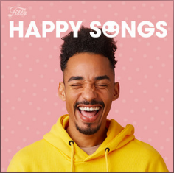


Mood Distribution
Home
Browse
8,000+ songs were classified into three basic moods; happy, sad and angry.
The track must have appeared in at least 2 playlists for that mood to be classified as such. If a song had multiple mood classifications, it would be attributed to the mood with the higher playlist count
Radio
Table of Content:
Business Problem
Data Overview
Track Attributes
Mood Distribution
Prediction Models
Recommendation Model
Prediction Distribution
Class Imbalance
Recommendation Sample
724 Songs
648 Songs
564 Songs
Next Steps
Donna Lee
Page: 4

Slide 6
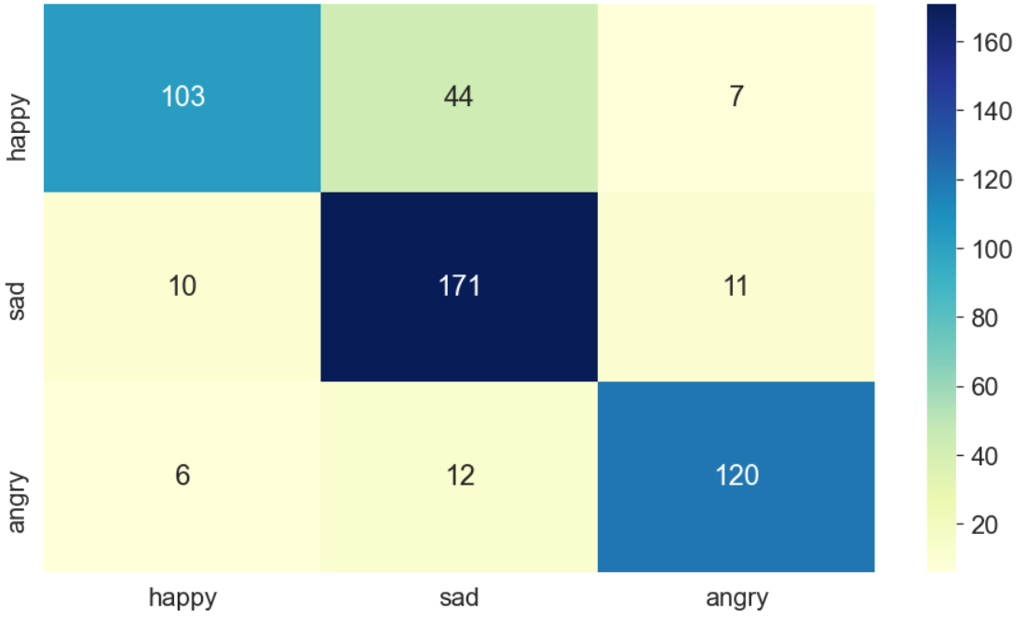
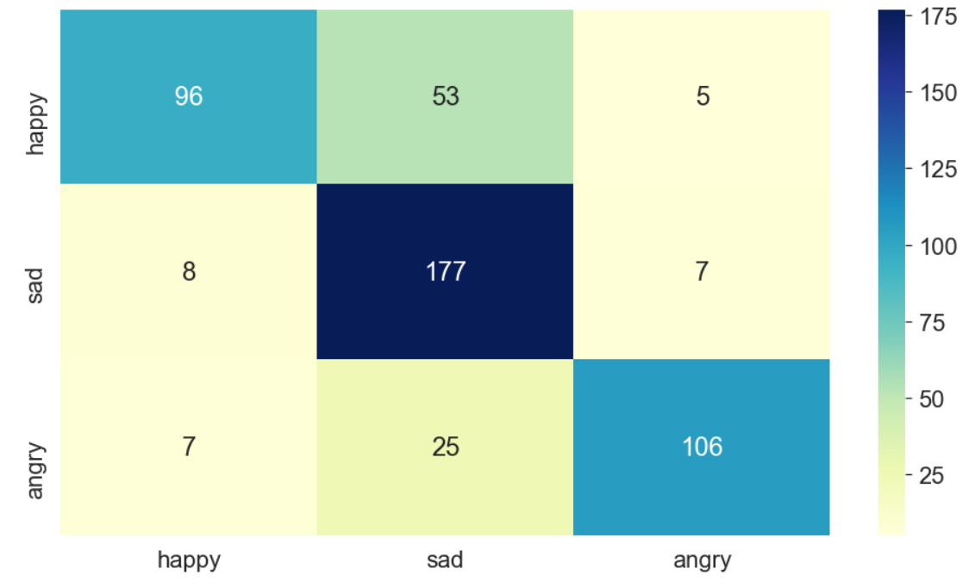
Mood Prediction Models
Home
Browse
Radio
To predict the mood of the remaining 500K+ songs that didn’t have labels, I ran both a Random Forest and KNN model.
In deciding which one was better, I evaluated them on the F1 score because precision and recall were equally as important.
Table of Content:
Business Problem
Data Overview
Track Attributes
Mood Distribution
Prediction Models
Recommendation Model
Prediction Distribution
Class Imbalance
Recommendation Sample
Random Forest Confusion Matrix
KNN Confusion Matrix
F1 Score: 0.82
F1 Score: 0.79
Next Steps
Donna Lee
Page: 5

Slide 7
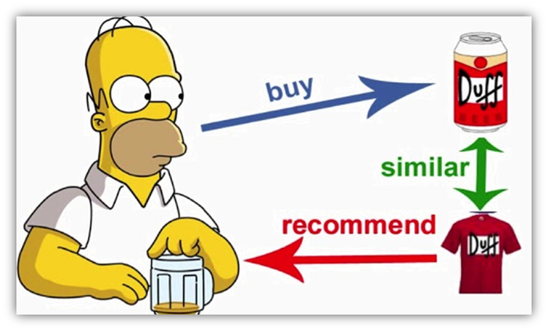
Recommendation Models
Home
Browse
Using the mood predictions, I created a recommendation system using Eculidean distance.
The engine takes in one song and the desired mood for the recommended songs. We will go through a sample in just a few moments!
Radio
Table of Content:
Business Problem
Data Overview
Track Attributes
Mood Distribution
Prediction Models
Recommendation Model
Prediction Distribution
Class Imbalance
Recommendation Sample
Next Steps
Donna Lee
Page: 6

Slide 8
Prediction Distribution
Home
Browse
When predicting songs with no mood labels, most tracks were categorized towards either sad or happy. There were far fewer angry songs most likely due to the overlap of features between angry and happy songs.
Radio
Table of Content:
Business Problem
Data Overview
Track Attributes
Mood Distribution
Prediction Models
Recommendation Model
Prediction Distribution
275K Songs
267K Songs
37K Songs
Class Imbalance
Recommendation Sample
Next Steps
Donna Lee
Page: 7

Slide 9
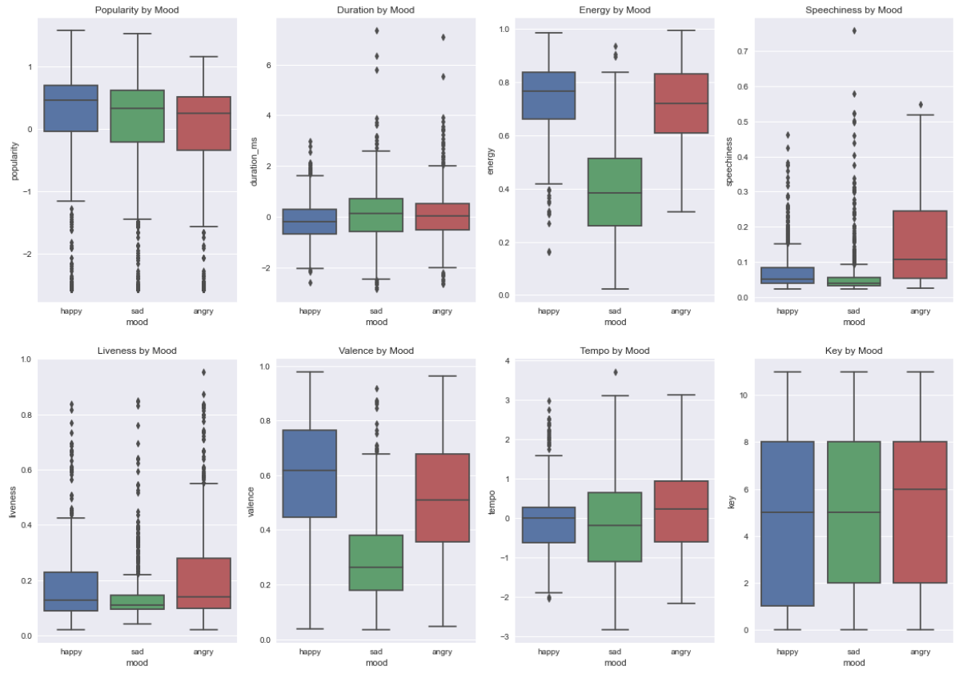
Class Imbalance
Home
Browse
Looking at the most important features from the prediction model, we can see that angry and happy songs had very similar audio makeup.
No wonder the model had a hard time differentiating the two!
Radio
Table of Content:
Business Problem
Data Overview
Track Attributes
Mood Distribution
Prediction Models
Recommendation Model
Prediction Distribution
Class Imbalance
Recommendation Sample
Next Steps
Donna Lee
Page: 7

Slide 10
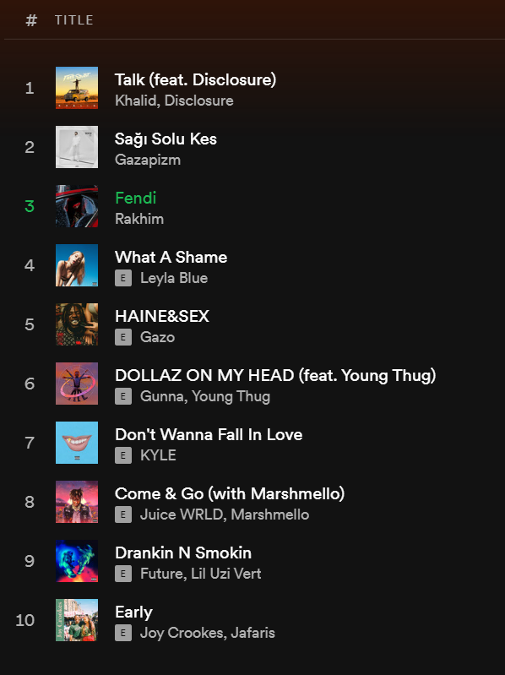
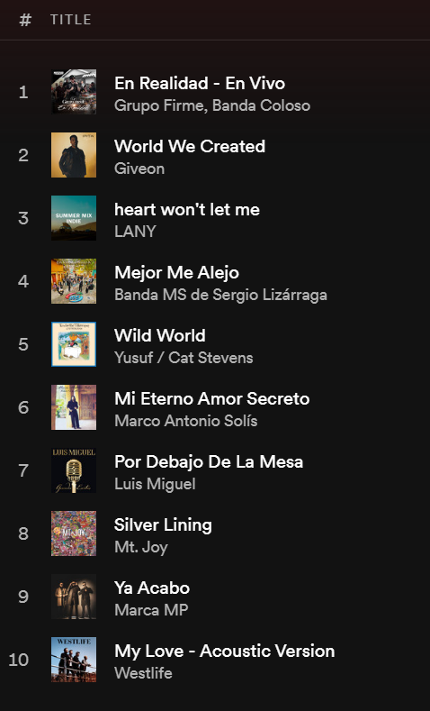
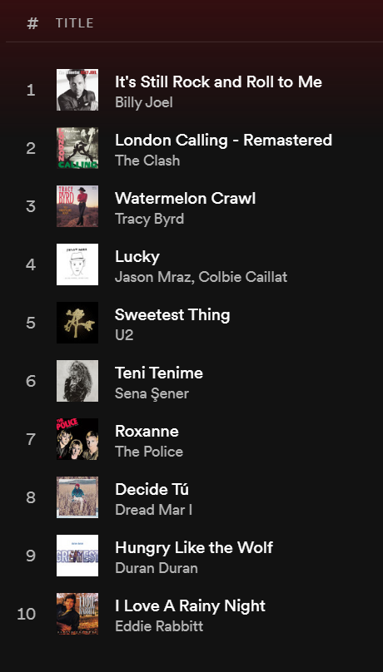
Prediction & Recommendation Sample
Home
Browse
Below are the top ten recommendations for each mood for Mariah Carey’s “We Belong Together”. Check it out and let me know what you think!
Radio
Table of Content:
Business Problem
Data Overview
Track Attributes
Mood Distribution
Prediction Models
Recommendation Model
Prediction Distribution
Class Imbalance
Recommendation Sample
Next Steps
Angry Recommendations
Sad Recommendations
Happy Recommendations
Donna Lee
Page: 8

Slide 11
Next Steps
Home
Browse
Use NLP on the lyrics to add to the prediction models
Introduce more moods to the model
Create a feature to automatically create a playlist off the recommendations
Radio
Table of Content:
Business Problem
Data Overview
Track Attributes
Mood Distribution
Prediction Models
Recommendation Model
Prediction Distribution
Class Imbalance
Recommendation Sample
Next Steps
Donna Lee
Page: 9

Slide 12
Spotify
Resources:
Kaggle Dataset - https://www.kaggle.com/yamaerenay/spotify-dataset-19212020-160k-tracks?select=data_w_genres.csv
Get a Playlist Spotify API - https://api.spotify.com/v1/playlists/{playlist_id}
Audio Features Spotify API - https://api.spotify.com/v1/audio-features
Get Several Tracks Spotify API - https://developer.spotify.com/console/get-several-tracks/

Slide 13
Spotify
Thank you! ...........
............................
Contact Information
LinkedIn: https://www.linkedin.com/in/donnalee0106/
GitHub:
https://github.com/dlee0106
E-Mail:
donna.lee0106@gmail.com
Blog:
https://donna-lee0106.medium.com/
Feel free to reach out!

